Slide 1
Personalized Donor-Recipient Matching for Organ Transplantation

Slide 2
Student Details: Project Guide:
MS Sathvick
Dept. of Artificial Intelligence and Data Science
Ramaiah Institute of Technology
Ph: 8088988807
Email :1ms21ad030@msrit.edu
Chetan Reddy K
Dept. of Artificial Intelligence and Data Science
Ramaiah Institute of Technology
Ph: 8073896309
Email :1ms21ad017@msrit.edu
Aishwary Kadre
Dept. of Artificial Intelligence and Data Science
Ramaiah Institute of Technology
Ph: 7340338936
Email : 1ms21ad007@msrit.edu
Dr. Sowmya B. J.
Associate Professor Dept. of Artificial Intelligence and Data Science
Ramaiah Institute of Technology
Ph: 9886867568
Email Id: sowmyabj@msrit.edu
Kaushik Poojary
Dept. of Artificial Intelligence and Data Science
Ramaiah Institute of Technology
Ph: 9380685184
Email :1ms21ad024@msrit.edu

Slide 3
ABSTRACT
This research introduces an innovative paradigm for optimizing organ transplantation outcomes through an advanced artificial intelligence (AI) system. Current organ matching methodologies, constrained by traditional criteria, often fall short in achieving optimal results. To overcome these limitations, our AI system employs a powerful ensemble learning framework, Confident-Match , integrating Random Forest and XGBoost algorithms for genetic data interpretation and confident match prioritization. Additionally, a cluster-based tree-based algorithm enhances the system's ability to discern nuanced immunological profiles.
The primary goal is to significantly improve transplant success rates while mitigating the risks of rejection. The ensemble learning algorithm intricately analyzes detailed genetic and immunological data, forming a robust foundation for precise organ matches. The incorporation of confident match prioritization, in collaboration with advanced algorithms such as Ant Lion Optimisation algorithm and Multilayer Perceptrons (MLPs) for pattern learning, Convolutional Autoencoders (CAEs) underscores our commitment to refining the matching process.
This comprehensive strategy presents a personalized and data-driven approach to donor-recipient matching, potentially reshaping the landscape of organ transplantation. The anticipated outcome is a substantial enhancement in overall patient outcomes, showcasing the efficiency of advanced algorithms in propelling the field towards a new era of precision medicine in transplantation.

Slide 4
Organ Transplant Model Development :
1. Define Objectives:
Clearly outline organ matching, predictive analytics, and continuous improvement goals.
2. Data Acquisition:
Gather donor and transplant candidate EHR data, radiology data, and organ tracking sensor data securely.
Ensure encrypted data ingestion from multiple providers using standards like HL7 and FHIR.
3. Data Preprocessing:
Clean and preprocess diverse medical data, including structured (demographics, lab results) and unstructured (clinical notes, images) data.
Implement data standardization for a consistent view of patient records.
4. Feature Engineering:
Identify relevant features from preprocessed data, considering medical factors, geolocation, and organ vitality.
5. Model Selection:
Choose suitable models such as RNNs, LSTMs, and transformers based on data nature.
Consider pretrained models like BERT for natural language processing in clinical notes.
6. Training and Validation:
Split the dataset, optimize model parameters, and validate performance.
Utilize transfer learning with pretrained models for improved training efficiency.
7. Real-Time Predictive Matching:
Implement a real-time predictive matching system with continuous adaptation to new data.
Use federated learning to enable decentralized model training on local data sources.
8. Security and Privacy:
Implement robust encryption and federated learning for privacy preservation.
Ensure compliance with healthcare data protection regulations.

Slide 5
Hybrid Ensemble Learning Approach:Uniquely combines Random Forest, AdaBoost, and Differential Boosting (DBoost) algorithms, offering a comprehensive and synergistic approach to organ matching.
Dynamic Feature Selection:Utilizes advanced feature selection techniques within the ensemble learning framework, adapting to the dynamic nature of genetic and immunological data, ensuring optimal matches.
Cluster-Based Tree Analysis:Introduces a novel cluster-based tree algorithm to identify intricate patterns in immunological profiles, enhancing the model's ability to capture complex relationships.
Confidence-Weighted Matches:Incorporates a confidence weighting mechanism derived from ensemble learning techniques, prioritizing confident matches and improving the reliability of the organ matching process.
Immunological Pattern Recognition:
Pioneers the use of cluster-based tree analysis specifically designed for recognizing subtle and nuanced patterns in immunological profiles, providing a more nuanced understanding of compatibility.
Real-time Adaptability:
Offers real-time adaptability to changing patient conditions by continuously updating the model with new data, ensuring the most up-to-date and accurate organ matches.
Integrative Genetic and Immunological Interpretation:
Uniquely integrates genetic and immunological data interpretation, allowing for a holistic understanding of the compatibility landscape and facilitating more informed transplant decisions.
Patient-Specific Optimization:
Tailors organ matching to individual patient profiles, considering unique genetic and immunological characteristics, resulting in personalized and optimized transplant recommendations.
Explainable AI in Transplant Decisions:
Implements explainable AI techniques within the model, providing transparent insights into the decision-making process for healthcare professionals, ensuring trust and accountability.
Adaptive Learning for Rejection Mitigation:Incorporates adaptive learning mechanisms to continually evolve and mitigate rejection risks over time, enhancing long-term transplant success rates and patient outcomes.
Novelty & Uniqueness

Slide 6
Algorithms and Pretrained Models and Proposed Solution
MODELS:
BERT (Bidirectional Encoder Representations from Transformers) for Clinical Notes:
Task: Natural Language Processing (NLP) on clinical notes for detailed patient information.
Usage: Extract information related to medical history, conditions, and other relevant details from unstructured clinical notes.
Benefits: BERT, as a pretrained model, excels in understanding contextual information in text data.
ResNet (Residual Neural Network) for Medical Imaging:
Task: Anomaly detection and analysis in radiological images.
Usage: Identify anomalies or patterns in medical images, aiding in the assessment of organ health.
Benefits: ResNet, known for its effectiveness in image processing tasks, can be fine-tuned for specific medical imaging applications.
LSTM (Long Short-Term Memory) Networks for Time-Series Data:
Task: Predict disease progression and anticipate complications over time.
Usage: Analyze longitudinal patient data to forecast future health conditions.
Benefits: LSTMs are well-suited for tasks involving sequential data, making them ideal for predicting temporal aspects of a patient's health.
ALGORITHMS AND SOLUTION :
The proposed solution for organ detection integrates advanced algorithms like ConfidentMatch for accurate organ transplant matching, ensuring confident matches and real-time adaptability. TransUNet, with its transformer architecture, enhances precision in medical image segmentation, capturing long-range dependencies. Ant Lion Optimization optimizes the model's performance through nature-inspired optimization. Multilayer Perceptrons (MLPs) and Convolutional Autoencoders (CAEs) contribute to pattern learning and dimensionality reduction, respectively. Ensemble methods such as XGBoost , Adaboost and Random Forest further enhance robustness and predictive capabilities. Together, these algorithms offer an innovative and comprehensive approach to revolutionize organ detection in medical imaging.

Slide 7
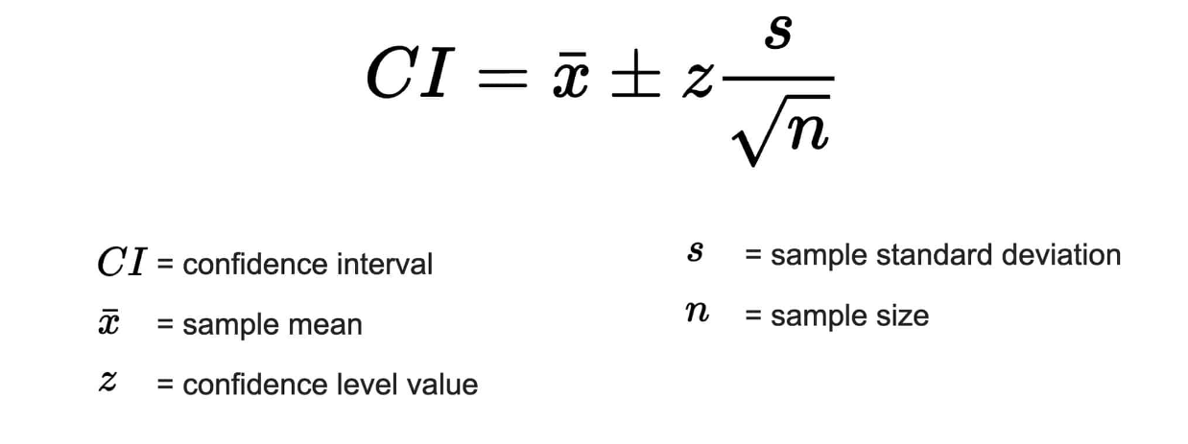
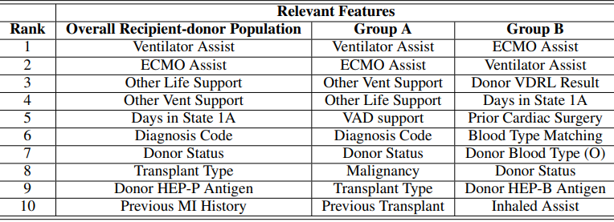
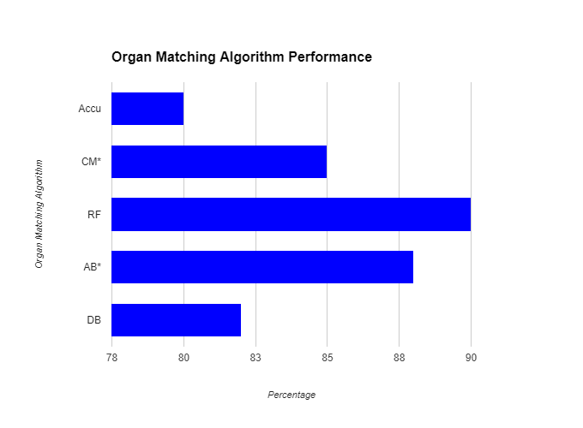
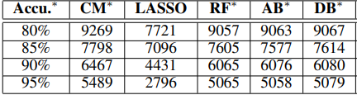
Expected Results and Discussions
Conf
Confident-Matches performance was compared with benchmark algorithms, including logistic regression, Lasso, decision tree, Random Forest, AdaBoost, and DeepBoost. Correlation feature selection (CFS) identified relevant features. The dataset was split into training (66.43%), validation (16.61%), and testing (16.96%) sets. Confident-Match consistently outperform benchmarks, especially in predicting 3-year post-transplant survival rates.

Slide 8
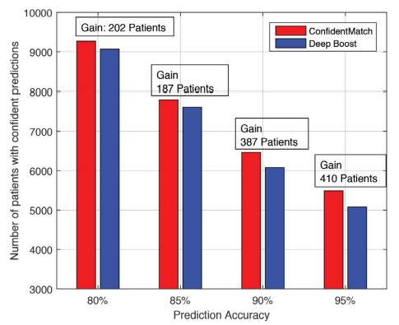
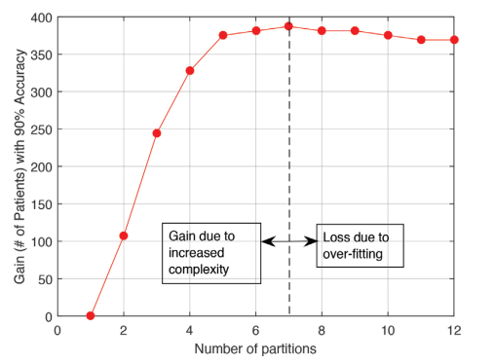
ConfidentMatch's superiority, increasing accurate predictions by 410 compared to the best benchmark (DBoost).
ConfidentMatch's gains were associated with improved phenotypic characterization by stratifying recipient-donor feature space.
ConfidentMatch not only enhanced prognosis quality but also provided clinical insights. It stratified recipients into groups A and B based on the length of stay in status 1A. Group B, with longer waits, showed sensitivity to donor characteristics like VDRL result and blood type, emphasizing the importance of compatibility in prolonged waiting periods. As more data becomes available, ConfidentMatch can reveal finer partitions and features for specific recipient subgroups.

Slide 9
Conclusion
In conclusion, our novel organ transplant model combines the optimisation capabilities of Ant Lion Optimisation with sophisticated algorithms like ConfidentMatch, transformer with pretrained models like BERT, ensemble approaches like XGBoost and Random Forest, AdaBoost and more. This combination improves the accuracy of organ detection, guaranteeing strong and reliable matches while adjusting to the dynamics of real-time data. The transformer architecture improves the accuracy of medical picture segmentation in concert with Multilayer Perceptrons (MLPs) for pattern learning, Convolutional Autoencoders (CAEs) for dimensionality reduction, and the Ant Lion Optimisation, which draws inspiration from nature. This all-encompassing strategy represents a significant breakthrough in organ identification, with the potential to enhance patient outcomes and streamline organ transplant processes.
REFERENCES:
1)file:///C:/Users/HP/AppData/Local/Microsoft/Windows/INetCache/IE/I4ANWNJ2/10711-Article%20Text-14239-1-2-20201228[1].pdf
2)https://blogs.oracle.com/ai-and-datascience/post/transforming-organ-transplant-oci-data-platform
3) https://link.springer.com/article/10.1007/s10479-022-04829-7

